Slide 1
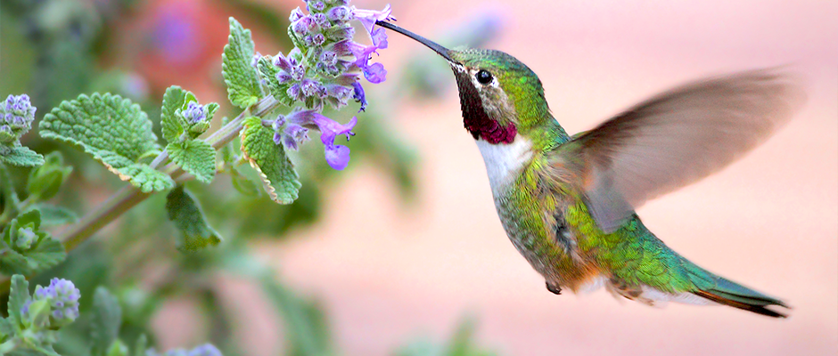
welcome

Slide 2
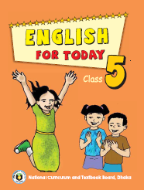
INTRODUCTION
Mahfuja Khatun
Asst. teacher
Moishala Gps
Pangsha, Rajbari.
Class-five
Subject- English
Unite-23
Lesson 2-3
Time: 45 minutes

Slide 3
Today’s lesson is
Stay safe!

Slide 4
Learning outcomes
Students will be able to---
1. Read words, phrases and sentences in the text with proper pronunciation, stress and intonation.
2. Ask and answer Wh questions.
3. Write a short composition about ‘natural disaster.

Slide 5
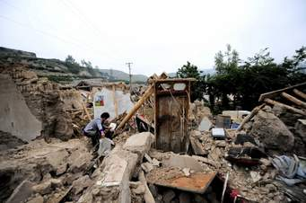
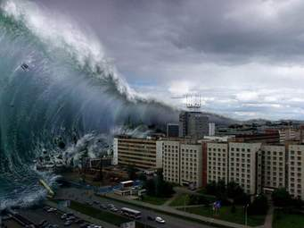
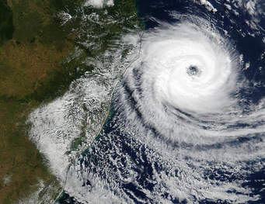
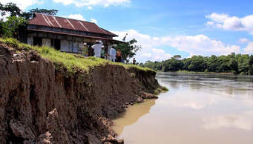
Look at the picture and talk about them
Earthquake
Tsunami
Cyclone
River erosion

Slide 6
Teacher’s loud reading and discuss the lesson
Open your EFT book at page 91.

Slide 7
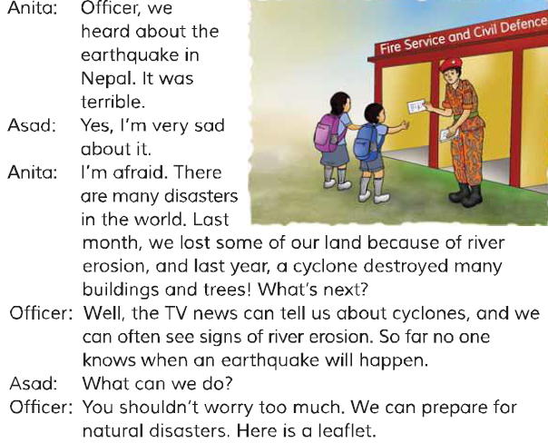
Listen, say and read.

Slide 8
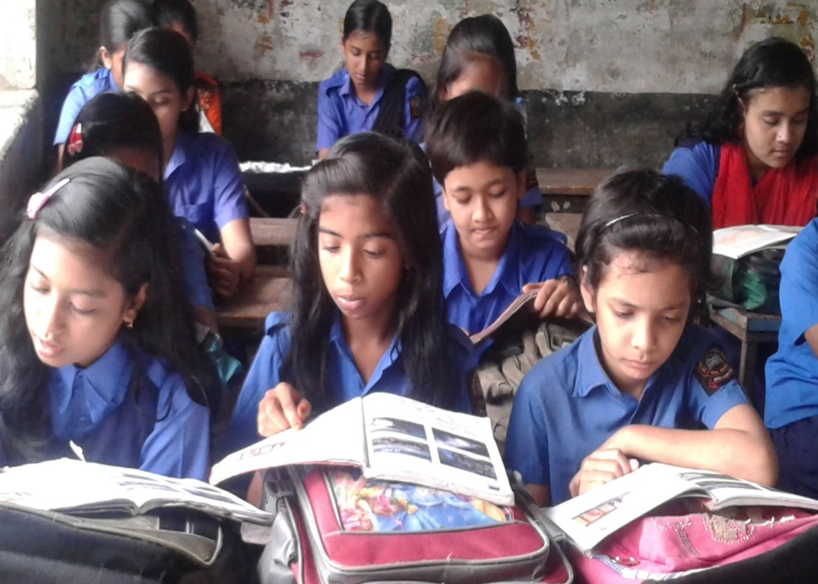
Student’s silent reading help by teacher

Slide 9
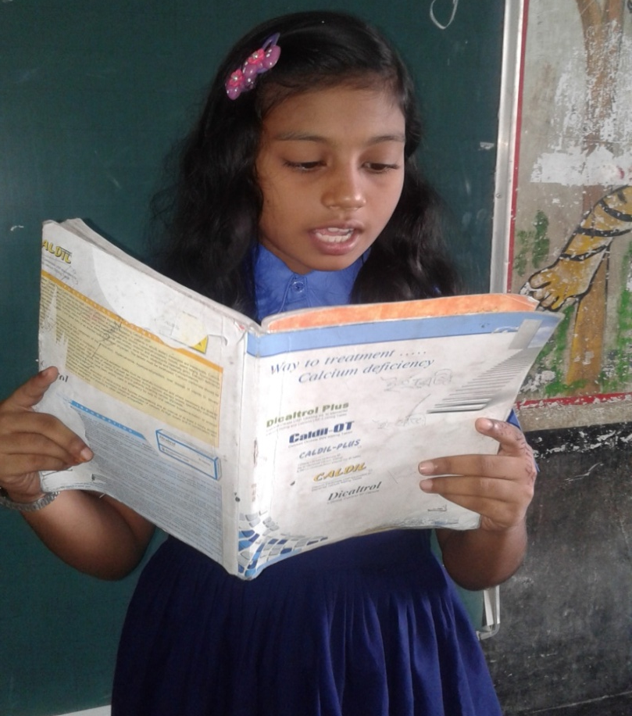
Students loud reading

Slide 10
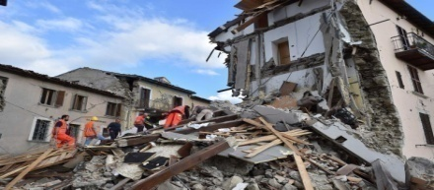
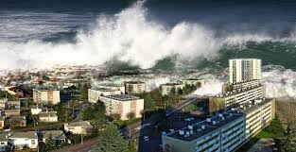
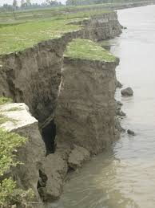
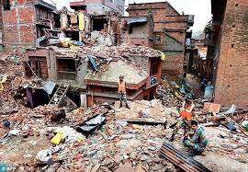
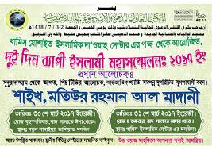
new words
Earthquake
Disasters
Erosion
Destroyed
Leaflet

Slide 11
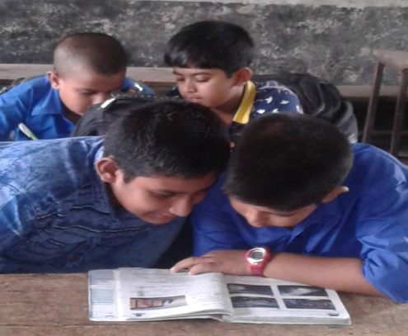
Pair work
Match the words of the column A with their meaning that is mentioned in the text in the column B.(there are two extra)
Matching
Column A | Column B
a. Hear | 1.To be fearful of
b. Sad | 2. On account of
c. Afraid | 3. A natural calamity
d. Disaster | 4. Signs of river erosion
e. Because of | 5. Destruction
 | 6. To listen to somebody
 | 7. To stay in a sorrowful condition

Slide 12
Group work
Answer the questions:
Write a short composition on ‘natural disasters’ at least in five sentences by answering the following questions:
a. What is called natural disaster?
b. Why does disasters occur?
c. What does cyclone do?
d. What is the present threat?
e. How can we face natural disasters?

Slide 13
Evaluation
Fill in the blanks.
a. Here Anita, Asad and an officer
are talking.
b.They about the earthquake in Nepal.
have heard
c. Anita afraid of it.
is
d. Asad very sad about it.
is
Common
e. Cyclone is in Bangladesh.

Slide 14
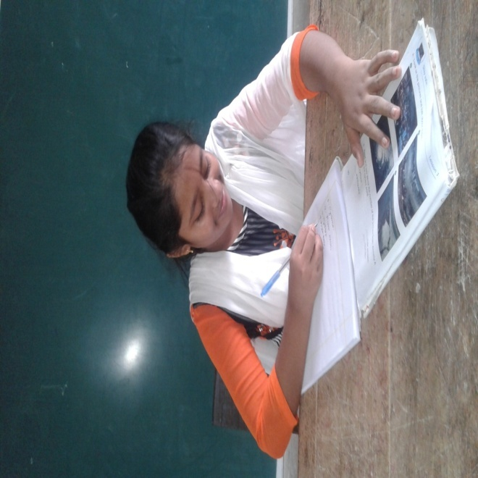
Home work
You will write a short composition about earthquake in five sentences.

Slide 15
THANK YOU

